Slide 1

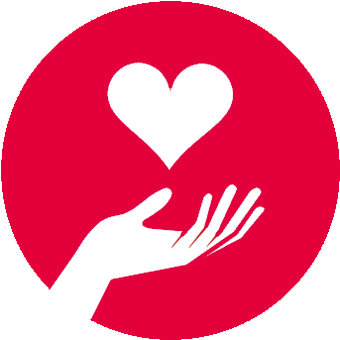
BITSY COIN
16290085 Y. Tuğba ÇeTin
16290125 K. Eylül Şengün

Slide 2
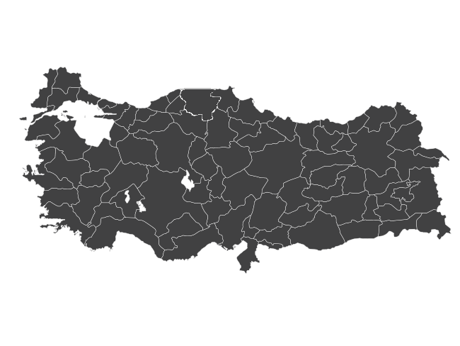

Volunteering
Solidarity

Slide 3
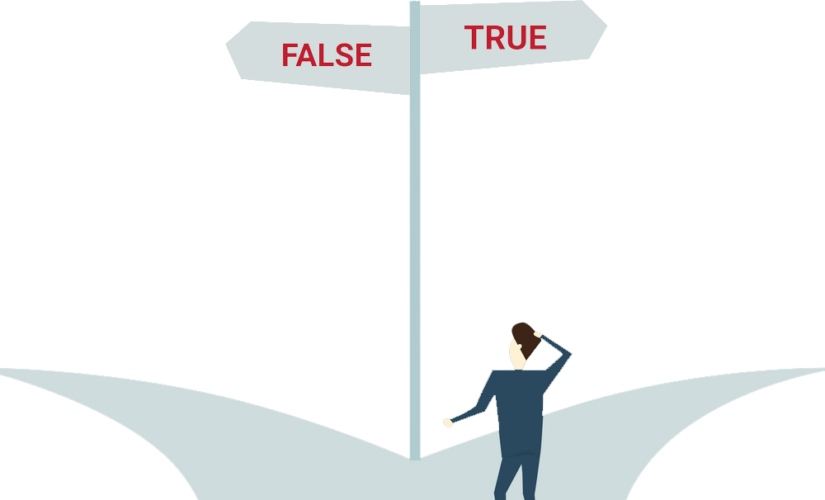
Where did the donations go?
Is the person or organization I donate reliable?
When will my help reach the person in need?
How can I let more people know that I need help?
Will the recipient use the money for its needs?

Slide 4

SolutIon: DOMESTIC PHILANTHROPY ORGANIZATION SYSTEM UsIng
BLOCKCHAIN

Slide 5
DONOR
VERIFIER
RECIPIENT
(DONEE)
ROLES
REGISTRATION AUTHORITY
PLATFORM

Slide 6
DONOR
Makes a donation by transferring money to the relevant campaign.
RECIPIENT (DONEE)
Receives the money and uses it accordingly.
PLATFORM
Monitors both the declarations of the donor and the donee and submits various reports.
REGISTRATION AUTHORITY
Manages the registration process of donors and donees.
VERIFIER
Ensures that the gathered money is used accordingly.

Slide 7
SOLUTION

Slide 8
OVERVIEW
REGISTRATION & RULES OF ROLES
All users of the system must verify their ID. For this, the verification system used by btcturk.com is used. Each user can take any role described previously, but some requirements must be met.
BITSY COIN & TRANSACTION
Bitsy Coin is signed exclusively for the transactions of each charity campaign. A campaign coin cannot be used for another charity campaign, and the funds that can be collected for each campaign are limited at the start of the campaign. The campaign is terminated if the amount required by the Recipient is collected.

Slide 9
OVERVIEW
INTEGRITY CONTROL
Before the campaign starts, the Verifier checks if the recipient really needs this help and checks if the money is actually used for the purpose at the end of the campaign. In case an inappropriate situation is encountered, it initiates the punishment procedure of the Recipient.
ETHICAL BEHAVIOUR MANAGEMENT
The Registration Authority, on the other hand, ensures that all players act ethically within the system while conducting the punishment process.

Slide 10
REGISTRATION
The following steps must be followed to create an account:
Your name and surname must be entered as written in your ID.
A valid email address must be entered. You must set a strong password.
After confirming your e-mail address, you can login.
The first time you log in, you will be asked to verify your GSM number.
Once you have verified your phone number, you should first read and approve the Illumination and Consent Text, which includes the Personal Data Protection Act and the Information and Declaration Form on your Rights under this Act.

Slide 11
REGISTRATION
You must enter your e-bill information before you can send money and start trading. Your account will be activated after your Turkish Identity Number and name and surname information is checked and verified from the Population and Citizenship Affairs database.
Now in Bitsy,through every bank in Turkey, you can perform Turkish Lira deposit and withdrawal transactions along with Bitsy Coin deposit and witdrawal transactions.
Account Confirmation
In order for your account to be approved, you must submit an identification document and a photo taken with it on the Account Confirmation page.

Slide 12
RULES OF ROLES
DONOR
Every player can be a donor. People who donate more to various campaigns earn reputation as trusted donors. This reputation is revoked when the donor is inactive for a certain period of time.
RECIPIENT
E.g. Invoiced list of materials and costs required for animal shelter repair, location of the shelter, a document on the condition of damaged areas, etc.
After your account approval, you must donate at least once for your first campaign creation. After your first donation, you can campaign for help after 48 hours have passed by the security procedure. However, in order to prove the accuracy of the campaign you have created, you should submit a document confirming that the standards set by the verifiers are met for the subject.

Slide 13
RULES OF ROLES
VERIFIER
Verifiers inspect recipients' accuracy at the beginning and end of the campaign. They must provide documents and information that can prove their competence. As a result of the evaluations and votes of the users within the system, they obtain the right to analyse specific campaigns as an expert. Each campaign is open to donation with the approval of at least three verifiers. (Delegated Proof of Stake)
REGISTIRATION AUTHORITY
This authority ensures that the procedures we have described in the registration section have been completed correctly. It also takes care of the platform-related portions of the penalties imposed by verifiers.

Slide 14
BITSY COIN
Bitsy will allow donors to convert Turkish Lira into Bitsy Coin at the current exchange rate, while the built-in wallet will allow every registered user to easily manage and store Bitsy Coin tokens without using external services.

Slide 15
BITSY COIN
There is also a structure called BitsyWallet, a payment gateway that allows registered charities on the Bitsy platform to accept donations directly on their websites and in different crypto currencies and Turkish Lira, which are then instantly converted into Bitsy Coin. This is to allow charities to manage all donations received in a single wallet in a simple way and provide transparency and traceability through Bitsy.
BitsyWallet also allows you to convert money into Turkish lira in case of possible fluctuations. These converted funds cannot be used by the donor before the end of the campaign. The campaign must also be verified.

Slide 16
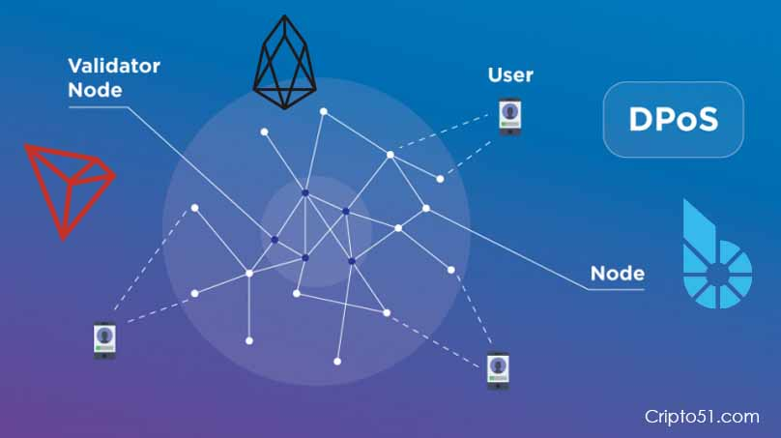
TRANSACTION
Through the Volunteering Ethics Tracking System, donors will be able to learn about every moment of donation.

Slide 17
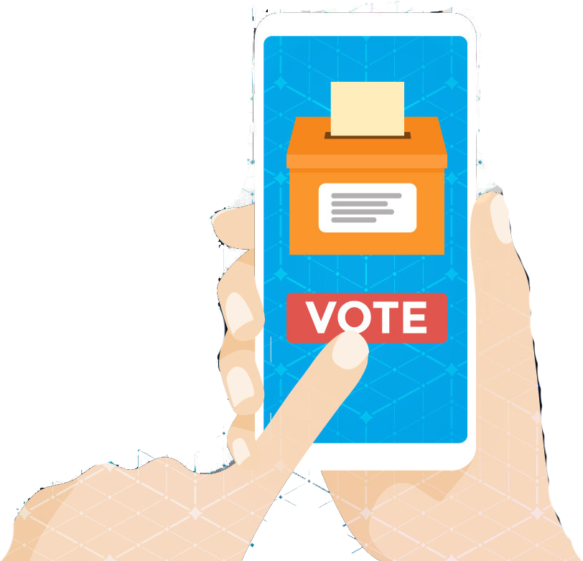
INTEGRITY CONTROL
When a possible manipulation or illegal situation is detected, the verifier informs other users in the system with justification.
For example, if an inaccuracy is detected in the documents of the person in need of the donation during the campaign process, the verifier will notify it to other users in the system.
As a result of voting in the system, donations are withdrawn from BitsyWallet of the recipient and returned to the donors if deemed necessary. The donee is discredited in the system and cannot create a new donation campaign for three months.

Slide 18
SECURITY ISSUES

Slide 19
SECURITY AGAINST A MALICIOUS DONEE
The recipient can log into the system by creating a fake ID and redirect the donation to himself/herself.
SOLUTION
In solution part, we talked about the registration process of the system. By using that steps, we can eliminate this issue.

Slide 20
SecurIty AgaInst a MalIcIous DONOR
It can increase their reputation by transferring less money than promised.
SOLUTION
BitsyWallet prevents the manipulation to be done with the exchange rate since the exchange rate at the time of transaction is considered valid. Also blockchain technology to be used in transactions prevents this fraud.

Slide 21
SECURITY AGAINST A MALICIOUS VERIFIER
Verifiers can be corrupted by recipients with the promise of a share of the donation.
SOLUTION
Just as verifiers control campaigns, users within the system control the verifiers with votes.

Slide 22
SECURITY AGAINST A MALICIOUS VERIFIER
The verifier may modify the report specifying the amount the recipient will receive.
The verifier may prefer not to fulfill his/her responsibilities.
SOLUTION
A single verifier has no right to say for the collected donation. More than one data is required for acceptance. Just like the donor, the verifier is voted against such a situation.

Slide 23
CHALLENGES

Slide 24
It must be proven by the system that the recipient uses the collected donation for its intended purpose.
SOLUTION
This challenge was overcome by verifiers verifying the recipient's actions and report of payment. In this verification process, the verification of a single verifier is not sufficient. All verifiers are required to confirm that the recipient uses the money at the relevant location.

Slide 25
The token which will be used for the management of donations should be recognized and accepted as a fiat currency by the government of Turkey and the organizations inside Turkey.
SOLUTION
The biggest challenge we face in the solution process is that the generated tokens reach a fixed value against the Turkish lira. Although arrangements are made through various institutions to make donation organizations more effective in the country, it is not sufficient. Therefore, it is necessary to encourage people to the system by providing the necessary authorities with demonstrative demonstrations that blockchain technology facilitates these processes.

Slide 26
Preventing the use of tokens for any other campaign or between donors.
SOLUTION
There is a method called multisig. To overcome this challenge we will try to adapt this method to charity organizations. The service provider in this system will be Bitsy.

Slide 27
The amount of money the campaign needs should be determined and the amount of money to be collected should be limited accordingly.
SOLUTION
Verifiers examine the documents submitted by the person or organization collecting the donations. At the end of the necessary reviews, the total amount of needs offered is limited by Bitsy and the campaign's BitsyWallet cannot receive any more BitsyCoins.

Slide 28
Insurmountable challenges
The verifiers on the board may exhibit malicious behavior through manipulations of donors, donee, or other verifiers. This number may be large enough to affect the voting system.
In accordance with the principle of voluntarism, no income should be generated other than those in need of assistance in any transaction within the system. However, players with major roles in the system, such as verifiers, must be kept active in the system.
For this reason, it is a challenge that we cannot solve to ensure that the verifier who creates transaction records is continuous in the system without profit.

Slide 29
MOTIVATION

Slide 30
The motivation of the system is that the people in need reach too many users. The system also eliminates intercomers and increases the accuracy of the collected help reaching those who really need it. Since all users in the system adopt the principle of volunteering, there is no motivation for profit.

Slide 31
According to an article written by Professor Peter Vogel and Malgorzata Kurak, “the key benefit of blockchain for philanthropy is that it enables more transparency and accountability.
They say, the application of blockchain technology to the philanthropy system has some benefits and drawbacks.

Slide 32
Benefits and drawbacks for donors
BENEFITS
Transactions at a higher speed and lower cost
Transactions performed on blockchain can reach recipients faster and at a lower cost because all transactions are posted immediately and are available to everyone. This also helps to increase the transparency.
2. Highly visible and traceable transactions
Blockchain allows philanthropists to track all their transactions. By monitoring the entire sequence of transactions, donors can easily find out whether their funds reached their intended target.

Slide 33
Benefits and drawbacks for donors
DRAWBACKS
Overrated ability to provide trust
Blockchain has no central governing body or auditor. This means that there is no one to take responsibility for the failure of the system if neccessary.
2. High energy consumption
Because cryptocurrencies store every transaction, this technology can help donors verify whether their funds were spent in line with their intentions. But this crypto-mining process is a massive consumer of energy.

Slide 34
Benefits and drawbacks for recipients
BENEFITS
More money, faster and increased security
Blockchain allows recipients to receive more money than they would have. Because expensive transfer mechanisms are bypassed, donors send more money directly to the recipients and fraudulent intermediaries are prevented from pocketing the money.

Slide 35
Benefits and drawbacks for recipients
DRAWBACKS
1. Uncertainty and cyber-crime
With increasing volumes of transactions, tracing where the money is going will become harder. This can make cryptocurrencies attractive to criminals. Although, it is becoming harder to participate in the major blockchains it is still problematic to resolve this issue.

Slide 36
CONCLUSION

